Slide 1
Introduction to SQL

Slide 2
Outline
Overview of The SQL Query Language
SQL Data Definition
Basic Query Structure of SQL Queries
Additional Basic Operations
Set Operations
Null Values
Aggregate Functions
Nested Subqueries
Modification of the Database
Notes:
1
In this chapter, as well as in Chapter 4 and Chapter 5, we study the most widely used database query language, SQL.
Although we refer to the SQL language as a “query language,” it can do much more than just query a database. It can define the structure of the data, modify data in the database, and specify security constraints.
It is not our intention to provide a complete users’ guide for SQL. Rather, we present SQL’s fundamental constructs and concepts. Individual implementations of SQL may differ in details or may support only a subset of the full language.

Slide 3
History
IBM Sequel language developed as part of System R project at the IBM San Jose Research Laboratory
Renamed Structured Query Language (SQL)
ANSI and ISO standard SQL:
SQL-86
SQL-89
SQL-92
SQL:1999 (language name became Y2K compliant!)
SQL:2003
SQL:2006, SQL:2008, SQL:2011, and most recently SQL:2016
Commercial systems offer most, if not all, SQL-92 features, plus varying feature sets from later standards and special proprietary features.
Not all examples here may work on your particular system.
Notes:
IBM developed the original version of SQL, originally called Sequel, as part of the System R project in the early 1970s. The Sequel language has evolved since then, and its name has changed to SQL (Structured Query Language). Many products now support the SQL language. SQL has clearly established itself as the standard relational database language.
In 1986, the American National Standards Institute (ANSI) and the International Organization for Standardization (ISO) published an SQL standard, called SQL-86. ANSI published an extended standard for SQL, SQL-89, in 1989.
The next version of the standard was SQL-92 standard, followed by SQL:1999, SQL:2003, SQL:2006, SQL:2008, SQL:2011, and most recently SQL:2016.
Posleden bulet da se pomine

Slide 4
SQL Parts
DML -- provides the ability to query information from the database and to insert tuples into, delete tuples from, and modify tuples in the database.
integrity – the DDL includes commands for specifying integrity constraints.
View definition -- The DDL includes commands for defining views.
Transaction control –includes commands for specifying the beginning and ending of transactions.
Embedded SQL and dynamic SQL -- define how SQL statements can be embedded within general-purpose programming languages.
Authorization – includes commands for specifying access rights to relations and views.
Notes:
The SQL language has several parts:
Data-definition language (DDL). The SQL DDL provides commands for defining relation schemas, deleting relations, and modifying relation schemas.
Data-manipulation language (DML). The SQL DML provides the ability to query information from the database and to insert tuples into, delete tuples from, and modify tuples in the database.
Integrity. The SQL DDL includes commands for specifying integrity constraints that the data stored in the database must satisfy. Updates that violate integrity constraints are disallowed.
View definition. The SQL DDL includes commands for defining views.
Transaction control. SQL includes commands for specifying the beginning and end points of transactions.
Embedded SQL and dynamic SQL. Embedded and dynamic SQL define how SQL statements can be embedded within general-purpose programming languages, such as C, C++, and Java.
Authorization. The SQL DDL includes commands for specifying access rights to relations and views.

Slide 5
Data Definition Language
The SQL data-definition language (DDL) allows the specification of information about relations, including:
The schema for each relation.
The type of values associated with each attribute.
The Integrity constraints
The set of indices to be maintained for each relation.
Security and authorization information for each relation.
The physical storage structure of each relation on disk.
Notes:
The set of relations in a database are specified using a data-definition language (DDL).
The SQL DDL allows specification of not only a set of relations, but also information about each relation, including:
The schema for each relation.
The types of values associated with each attribute.
The integrity constraints.
The set of indices to be maintained for each relation.
The security and authorization information for each relation.
The physical storage structure of each relation on disk.

Slide 6
Domain Types in SQL
char(n). Fixed length character string, with user-specified length n.
varchar(n). Variable length character strings, with user-specified maximum length n.
int. Integer (a finite subset of the integers that is machine-dependent).
smallint. Small integer (a machine-dependent subset of the integer domain type).
numeric(p,d). Fixed point number, with user-specified precision of p digits, with d digits to the right of decimal point. (ex., numeric(3,1), allows 44.5 to be stores exactly, but not 444.5 or 0.32)
real, double precision. Floating point and double-precision floating point numbers, with machine-dependent precision.
float(n). Floating point number, with user-specified precision of at least n digits.
More are covered in Chapter 4.
Notes:
The SQL standard supports a variety of built-in types, including:
char(n): A fixed-length character string with user-specified length n. The full form, character, can be used instead.
varchar(n): A variable-length character string with user-specified maximum length n. The full form, character varying, is equivalent.
int: An integer (a finite subset of the integers that is machine dependent). The full form, integer, is equivalent.
smallint: A small integer (a machine-dependent subset of the integer type).
numeric(p, d): A fixed-point number with user-specified precision. The number consists of p digits (plus a sign), and d of the p digits are to the right of the decimal point. Thus, numeric(3,1) allows 44.5 to be stored exactly, but neither 444.5 nor 0.32 can be stored exactly in a field of this type.
real, double precision: Floating-point and double-precision floating-point numbers with machine-dependent precision.
float(n): A floating-point number with precision of at least n digits.
Additional types are covered in Section 4.5.
Each type may include a special value called the null value. A null value indicates an absent value that may exist but be unknown or that may not exist at all. In certain cases, we may wish to prohibit null values from being entered, as we shall see shortly.

Slide 7
Create Table Construct
An SQL relation is defined using the create table command:
create table r
(A₁ D₁, A₂ D₂, ..., A_{n} D_{n}, (integrity-constraint₁), ..., (integrity-constraint_{k}))
r is the name of the relation
each A_{i} is an attribute name in the schema of relation r
D_{i} is the data type of values in the domain of attribute A_{i}
Example:
create table instructor ( ID char(5), name varchar(20), dept_name varchar(20), salary numeric(8,2))
Notes:
The general form of the create table command is:
create table r
(A₁ D₁, A₂ D₂, ..., A_{n} D_{n},
(integrity-constraint₁), ..., (integrity-constraint_{k}))
where r is the name of the relation, each Ai is the name of an attribute in the schema of relation r, and Di is the domain of attribute Ai ; that is, Di specifies the type of attribute Ai along with optional constraints that restrict the set of allowed values for Ai.
We define an SQL relation by using the create table command. The following command creates a relation department in the database:
create table instructor ( ID char(5), name varchar(20), dept_name varchar(20), salary numeric(8,2))
The relation created above has three attributes, dept_name, which is a character string of maximum length 20, building, which is a character string of maximum length 15, and budget, which is a number with 12 digits in total, two of which are after the decimal point. The create table command also specifies that the dept name attribute is the primary key of the department relation.
The semicolon shown at the end of the create table statements, as well as at the end of other SQL statements later in this chapter, is optional in many SQL implementations.

Slide 8
Integrity Constraints in Create Table
Types of integrity constraints
primary key (A₁, ..., A_{n} )
foreign key (A_{m}, ..., A_{n} ) references r
not null
SQL prevents any update to the database that violates an integrity constraint.
Example:
create table instructor ( ID char(5), name varchar(20) not null, dept_name varchar(20), salary numeric(8,2), primary key (ID), foreign key (dept_name) references department);
Notes:
SQL supports a number of different integrity constraints. In this section, we discuss only a few of them:
primary key (A_{j1} , A_{j2} , …, A_{jm} ): The primary-key specification says that attributes A_{j1} , A_{j2} , …, A_{jm} form the primary key for the relation. The primary-key attributes are required to be nonnull and unique; that is, no tuple can have a null value for a primary-key attribute, and no two tuples in the relation can be equal on all the primary-key attributes. Although the primary-key specification is optional, it is generally a good idea to specify a primary key for each relation.
foreign key (A_{k1} , A_{k2} , …, A_{kn} ) references s: The foreign key specification says that the values of attributes (A_{k1} , A_{k2} , …, A_{kn} ) for any tuple in the relation must correspond to values of the primary key attributes of some tuple in relation s.
Figure 3.1 presents a partial SQL DDL definition of the university database we use in the text. The definition of the course table has a declaration “foreign key (dept name) references department”. This foreign-key declaration specifies that for each course tuple, the department name specified in the tuple must exist in the primary key attribute (dept name) of the department relation. Without this constraint, it is possible for a course to specify a nonexistent department name. Figure 3.1 also shows foreign-key constraints on tables section, instructor and teaches. Some database systems, including MySQL, require an alternative syntax, “foreign key (dept name) references department(dept name)”, where the referenced attributes in the referenced table are listed explicitly.
not null: The not null constraint on an attribute specifies that the null value is not allowed for that attribute; in other words, the constraint excludes the null value from the domain of that attribute. For example, in Figure 3.1, the not null constraint on the name attribute of the instructor relation ensures that the name of an instructor cannot be null.

Slide 9
And a Few More Relation Definitions
create table student ( ID varchar(5), name varchar(20) not null, dept_name varchar(20), tot_cred numeric(3,0), primary key (ID),
foreign key (dept_name) references department);
create table takes ( ID varchar(5), course_id varchar(8), sec_id varchar(8), semester varchar(6), year numeric(4,0), grade varchar(2),
primary key (ID, course_id, sec_id, semester, year) ,
foreign key (ID) references student, foreign key (course_id, sec_id, semester, year) references section);
Notes:
Figure 3.1 presents a partial SQL DDL definition of the university database we use in the text. The definition of the course (student) table has a declaration “foreign key (dept name) references department”. This foreign-key declaration specifies that for each course (student) tuple, the department name specified in the tuple must exist in the primary key attribute (dept_name) of the department relation. Without this constraint, it is possible for a course to specify a nonexistent department name. Figure 3.1 also shows foreign-key constraints on tables section, instructor and teaches. Some database systems, including MySQL, require an alternative syntax, “foreign key (dept_name) references department(dept_name)”, where the referenced attributes in the referenced table are listed explicitly.

Slide 10
And more still
create table course ( course_id varchar(8), title varchar(50), dept_name varchar(20), credits numeric(2,0),
primary key (course_id),
foreign key (dept_name) references department);
Notes:
This foreign-key declaration specifies that for each course tuple, the department name specified in the tuple must exist in the primary key attribute (dept_name) of the department relation
Next table from university database

Slide 11
Updates to tables
Insert
insert into instructor values ('10211', 'Smith', 'Biology', 66000);
Delete
Remove all tuples from the student relation
delete from student
Drop Table
drop table r
Alter
alter table r add A D
where A is the name of the attribute to be added to relation r and D is the domain of A.
All exiting tuples in the relation are assigned null as the value for the new attribute.
alter table r drop A
where A is the name of an attribute of relation r
Dropping of attributes not supported by many databases.
Notes:
SQL prevents any update to the database that violates an integrity constraint. For example, if a newly inserted or modified tuple in a relation has null values for any primary-key attribute, or if the tuple has the same value on the primary-key attributes as does another tuple in the relation, SQL flags an error and prevents the update. Similarly, an insertion of a course tuple with a dept_name value that does not appear in the department relation would violate the foreign-key constraint on course, and SQL prevents such an insertion from taking place.
A newly created relation is empty initially. Inserting tuples into a relation, updating them, and deleting them are done by data manipulation statements insert, update, and delete, which are covered in Section 3.9.
To remove a relation from an SQL database, we use the drop table command. The drop table command deletes all information about the dropped relation from the database. The command
drop table r;
is a more drastic action than
delete from r;
The latter retains relation r, but deletes all tuples in r. The former deletes not only all tuples of r, but also the schema for r. After r is dropped, no tuples can be inserted into r unless it is re-created with the create table command.
We use the alter table command to add attributes to an existing relation. All tuples in the relation are assigned null as the value for the new attribute. The form of the alter table command is
alter table r add A D;
where r is the name of an existing relation, A is the name of the attribute to be added, and D is the type of the added attribute. We can drop attributes from a relation by the command
alter table r drop A;
where r is the name of an existing relation, and A is the name of an attribute of the relation. Many database systems do not support dropping of attributes, although they will allow an entire table to be dropped.

Slide 12
Basic Query Structure
A typical SQL query has the form: select A₁, A₂, ..., A_{n} from r₁, r₂, ..., r_{m} where P
A_{i} represents an attribute
R_{i} represents a relation
P is a predicate.
The result of an SQL query is a relation.
Notes:
2
The basic structure of an SQL query consists of three clauses: select, from, and where. A query takes as its input the relations listed in the from clause, operates on them as specified in the where and select clauses, and then produces a relation as the result. We introduce the SQL syntax through examples, and we describe the general structure of SQL queries later.

Slide 13
The select Clause
The select clause lists the attributes desired in the result of a query
corresponds to the projection operation of the relational algebra
Example: find the names of all instructors: select name from instructor
NOTE: SQL names are case insensitive (i.e., you may use upper- or lower-case letters.)
E.g., Name ≡ NAME ≡ name
Some people use upper case wherever we use bold font.
Notes:
3
Let us consider a simple query using our university example, “Find the names of all instructors.” Instructor names are found in the instructor relation, so we put that relation in the from clause. The instructor’s name appears in the name attribute, so we put that in the select clause.
select name from instructor
The result is a relation consisting of a single attribute with the heading name. If the instructor relation is as shown in Figure 2.1, then the relation that results from the preceding query is shown in Figure 3.2.

Slide 14
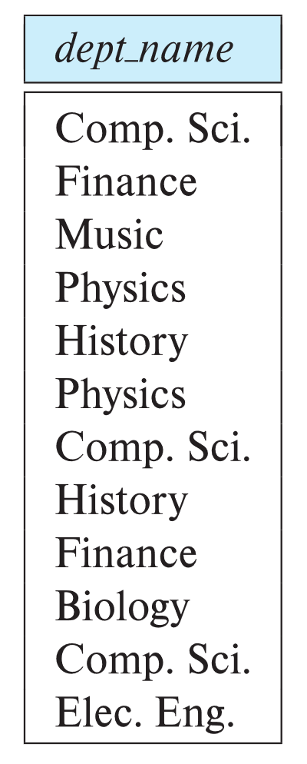
The select Clause (Cont.)
SQL allows duplicates in relations as well as in query results.
To force the elimination of duplicates, insert the keyword distinct after select.
Find the department names of all instructors, and remove duplicates
select distinct dept_name from instructor
The keyword all specifies that duplicates should not be removed.
select all dept_name from instructor
Notes:
4
Now consider another query, “Find the department names of all instructors,” which can be written as:
select dept_name
from instructor;
Since more than one instructor can belong to a department, a department name could appear more than once in the instructor relation. The result of the above query is a relation containing the department names, shown in Figure 3.3.
In the formal, mathematical definition of the relational model, a relation is a set. Thus, duplicate tuples would never appear in relations. In practice, duplicate elimination is time-consuming. Therefore, SQL allows duplicates in database relations as well as in the results of SQL expressions.1 Thus, the preceding SQL query lists each department name once for every tuple in which it appears in the instructor relation.
In those cases where we want to force the elimination of duplicates, we insert the keyword distinct after select. We can rewrite the preceding query as:
select distinct dept_name
from instructor;
if we want duplicates removed. The result of the above query would contain each department name at most once.

Slide 15
The select Clause (Cont.)
An asterisk in the select clause denotes “all attributes”
select * from instructor
An attribute can be a literal with no from clause
select '437'
Results is a table with one column and a single row with value “437”
Can give the column a name using:
select '437' as FOO
An attribute can be a literal with from clause
select 'A' from instructor
Result is a table with one column and N rows (number of tuples in the instructors table), each row with value “A”
Notes:
5
Since duplicate retention is the default, we shall not use all in our examples. To ensure the elimination of duplicates in the results of our example queries, we shall use distinct whenever it is necessary.
The select clause may also contain arithmetic expressions involving the operators +, −, ∗, and / operating on constants or attributes of tuples. For example, the query:
select ID, name, dept_name, salary * 1.1
from instructor;
returns a relation that is the same as the instructor relation, except that the attribute salary is multiplied by 1.1. This shows what would result if we gave a 10% raise to each instructor; note, however, that it does not result in any change to the instructor relation.

Slide 16
The select Clause (Cont.)
The select clause can contain arithmetic expressions involving the operation, +, –, ∗, and /, and operating on constants or attributes of tuples.
The query:
select ID, name, salary/12 from instructor
would return a relation that is the same as the instructor relation, except that the value of the attribute salary is divided by 12.
Can rename “salary/12” using the as clause:
select ID, name, salary/12 as monthly_salary
Notes:
5
The select clause may also contain arithmetic expressions involving the operators +, −, ∗, and / operating on constants or attributes of tuples. For example, the query:
select ID, name, dept_name, salary * 1.1
from instructor;
returns a relation that is the same as the instructor relation, except that the attribute salary is multiplied by 1.1 (divide by 12). This shows what would result if we gave a 10% raise to each instructor; note, however, that it does not result in any change to the instructor relation.

Slide 17
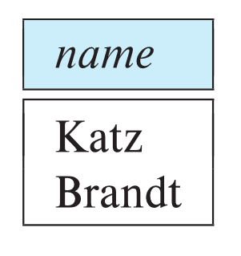
The where Clause
The where clause specifies conditions that the result must satisfy
Corresponds to the selection predicate of the relational algebra.
To find all instructors in Comp. Sci. dept
select name from instructor where dept_name = 'Comp. Sci.'
SQL allows the use of the logical connectives and, or, and not
The operands of the logical connectives can be expressions involving the comparison operators <, <=, >, >=, =, and <>.
Comparisons can be applied to results of arithmetic expressions
To find all instructors in Comp. Sci. dept with salary > 70000
select name from instructor where dept_name = 'Comp. Sci.' and salary > 70000
Notes:
6
The where clause allows us to select only those rows in the result relation of the from clause that satisfy a specified predicate. Consider the query “Find the names of all instructors in the Computer Science department who have salary greater than $70,000.” This query can be written in SQL as:
select name
from instructor
where dept_name = 'Comp. Sci.' and salary > 70000;
SQL allows the use of the logical connectives and, or, and not in the where clause. The operands of the logical connectives can be expressions involving the comparison operators <=, >, >=, =, and <>. SQL allows us to use the comparison operators to compare strings and arithmetic expressions, as well as special types, such as date types.
We shall explore other features of where clause predicates later in this chapter.

Slide 18
The from Clause
The from clause lists the relations involved in the query
Corresponds to the Cartesian product operation of the relational algebra.
Find the Cartesian product instructor X teaches
select ∗ from instructor, teaches
generates every possible instructor – teaches pair, with all attributes from both relations.
For common attributes (e.g., ID), the attributes in the resulting table are renamed using the relation name (e.g., instructor.ID)
Cartesian product not very useful directly, but useful combined with where-clause condition (selection operation in relational algebra).
Notes:
8

Slide 19
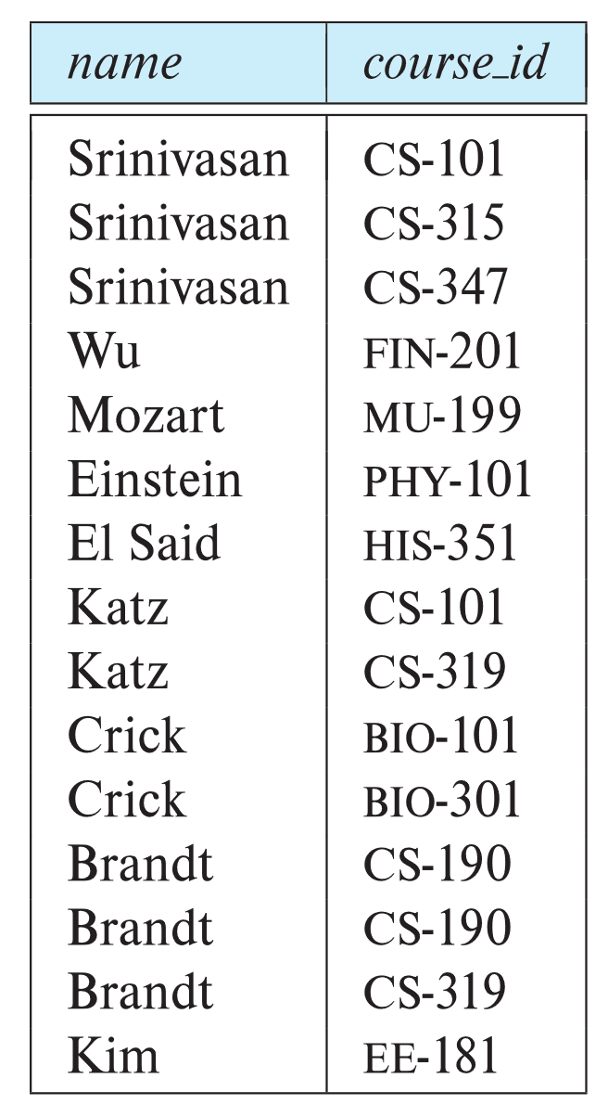
Examples
Find the names of all instructors who have taught some course and the course_id
select name, course_id from instructor , teaches where instructor.ID = teaches.ID
Find the names of all instructors in the Art department who have taught some course and the course_id
select name, course_id from instructor , teaches where instructor.ID = teaches.ID and instructor. dept_name = 'Art'
Notes:
9
Instead, the predicate in the where clause is used to restrict the combinations created by the Cartesian product to those that are meaningful for the desired answer. We would likely want a query involving instructor and teaches to combine a particular tuple t in instructor with only those tuples in teaches that refer to the same instructor to which t refers. That is, we wish only to match teaches tuples with instructor tuples that have the same ID value. The following SQL query ensures this condition and outputs the instructor name and course identifiers from such matching tuples.
select name, course id
from instructor, teaches
where instructor.ID= teaches.ID;
Note that the preceding query outputs only instructors who have taught some course. Instructors who have not taught any course are not output; if we wish to output such tuples, we could use an operation called the outer join, which is described in Section 4.1.3.
If the instructor relation is as shown in Figure 2.1 and the teaches relation is as shown in Figure 2.7, then the relation that results from the preceding query is shown in Figure 3.7. Observe that instructors Gold, Califieri, and Singh, who have not taught any course, do not appear in Figure 3.7.
If we wished to find only instructor names and course identifiers for instructors in the Computer Science department, we could add an extra predicate to the where clause, as shown below.
select name, course id
from instructor, teaches
where instructor.ID= teaches.ID and instructor.dept_name = 'Comp. Sci.';
Note that since the dept_name attribute occurs only in the instructor relation, we could have used just dept_name, instead of instructor.dept_name in the above query. In general, the meaning of an SQL query can be understood as follows:
Generate a Cartesian product of the relations listed in the from clause.
Apply the predicates specified in the where clause on the result of Step 1.
For each tuple in the result of Step 2, output the attributes (or results of expressions) specified in the select clause.

Slide 20
The Rename Operation
Consider again the query that we used earlier:
select name, course id
from instructor, teaches
where instructor.ID= teaches.ID;
name, course_id – result of the query
names of the attributes in the result are derived from the names of the attributes in the relations
Notes:
9
Da se dodade uste -1-2 slajda so tekstot podolu pred sljadot
Consider again the query that we used earlier:
select name, course id
from instructor, teaches
where instructor.ID= teaches.ID;
The result of this query is a relation with the following attributes:
name, course id
The names of the attributes in the result are derived from the names of the attributes in the relations in the from clause.
We cannot, however, always derive names in this way, for several reasons: First, two relations in the from clause may have attributes with the same name, in which case an attribute name is duplicated in the result. Second, if we use an arithmetic expression in the select clause, the resultant attribute does not have a name. Third, even if an attribute name can be derived from the base relations as in the preceding example, we may want to change the attribute name in the result.

Slide 21
The Rename Operation (cont…)
The SQL allows renaming relations and attributes using the as clause:
old-name as new-name
if we want the attribute name: name to be replaced with the name instructor name, we can rewrite the preceding query as
select name as instructor name, course_id
from instructor, teaches
where instructor.ID= teaches.ID;
For all instructors in the university who have taught some course, find their names and the course ID of all courses they taught.”
select T.name, S.course id
from instructor as T, teaches as S
where T.ID= S.ID;
Notes:
9
Hence, SQL provides a way of renaming the attributes of a result relation. It uses the as clause, taking the form:
old-name as new-name
The as clause can appear in both the select and from clauses.3 For example, if we want the attribute name: name to be replaced with the name instructor name, we can rewrite the preceding query as:
select name as instructor name, course_id
from instructor, teaches
where instructor.ID= teaches.ID;
The as clause is particularly useful in renaming relations. One reason to rename a relation is to replace a long relation name with a shortened version that is more convenient to use elsewhere in the query. To illustrate, we rewrite the query “For all instructors in the university who have taught some course, find their names and the course ID of all courses they taught.”
select T.name, S.course id
from instructor as T, teaches as S
where T.ID= S.ID;

Slide 22
The Rename Operation (cont…)
The SQL allows renaming relations and attributes using the as clause:
old-name as new-name
Find the names of all instructors who have a higher salary than some instructor in 'Comp. Sci'.
select distinct T.name from instructor as T, instructor as S where T.salary > S.salary and S.dept_name = 'Comp. Sci.’
Keyword as is optional and may be omitted instructor as T ≡ instructor T
Notes:
9
We cannot, however, always derive names in this way, for several reasons: First, two relations in the from clause may have attributes with the same name, in which case an attribute name is duplicated in the result. Second, if we use an arithmetic expression in the select clause, the resultant attribute does not have a name. Third, even if an attribute name can be derived from the base relations as in the preceding example, we may want to change the attribute name in the result.
Hence, SQL provides a way of renaming the attributes of a result relation. It uses the as clause, taking the form:
old-name as new-name
The as clause can appear in both the select and from clauses.3 For example, if we want the attribute name: name to be replaced with the name instructor name, we can rewrite the preceding query as:
select name as instructor name, course id
from instructor, teaches
where instructor.ID= teaches.ID;
The as clause is particularly useful in renaming relations. One reason to rename a relation is to replace a long relation name with a shortened version that is more convenient to use elsewhere in the query. To illustrate, we rewrite the query “For all instructors in the university who have taught some course, find their names and the course ID of all courses they taught.”
select T.name, S.course id
from instructor as T, teaches as S
where T.ID= S.ID;
Another reason to rename a relation is a case where we wish to compare tuples in the same relation. We then need to take the Cartesian product of a relation with itself and, without renaming, it becomes impossible to distinguish one tuple from the other. Suppose that we want to write the query “Find the names of all instructors whose salary is greater than at least one instructor in the Biology department.” We can write the SQL expression:
select distinct T.name
from instructor as T, instructor as S
where T.salary > S.salary and S.dept name = 'Biology';
In the above query, T and S can be thought of as copies of the relation instructor, but more precisely, they are declared as aliases, that is, as alternative names, for the relation instructor. An identifier, such as T and S, that is used to rename a relation is referred to as a correlation name in the SQL standard, but it is also commonly referred to as a table alias, or a correlation variable, or a tuple variable.

Slide 23
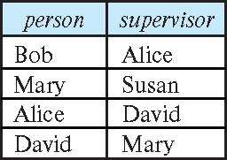
Self Join Example
Relation emp-super
Find the supervisor of “Bob”
Find the supervisor of the supervisor of “Bob”
Can you find ALL the supervisors (direct and indirect) of “Bob”?
Notes:
9

Slide 24
String Operations
SQL includes a string-matching operator for comparisons on character strings. The operator like uses patterns that are described using two special characters:
percent ( % ). The % character matches any substring.
underscore ( _ ). The _ character matches any character.
Find the names of all instructors whose name includes the substring “dar”.
select name from instructor where name like '%dar%'
Match the string “100%”
like '100 \%' escape '\'
in that above we use backslash (\) as the escape character.
Notes:
SQL specifies strings by enclosing them in single quotes, for example, 'Computer'. A single quote character that is part of a string can be specified by using two single quote characters; for example, the string “It’s right” can be specified by 'It''s right'.
SQL also permits a variety of functions on character strings, such as concatenating (using “∥”), extracting substrings, finding the length of strings, converting strings to uppercase (using the function upper(s) where s is a string) and lowercase (using the function lower(s)), removing spaces at the end of the string (using trim(s)), and so on. There are variations on the exact set of string functions supported by different database systems. See your database system’s manual for more details on exactly what string functions it supports.
Pattern matching can be performed on strings using the operator like. We describe patterns by using two special characters:
• Percent (%): The % character matches any substring.
• Underscore (_): The character matches any character.

Slide 25
String Operations (Cont.)
Patterns are case sensitive.
Pattern matching examples:
'Intro%' matches any string beginning with “Intro”.
'%Comp%' matches any string containing “Comp” as a substring.
'_ _ _' matches any string of exactly three characters.
'_ _ _ %' matches any string of at least three characters.
SQL supports a variety of string operations such as
concatenation (using “||”)
converting from upper to lower case (and vice versa)
finding string length, extracting substrings, etc.
Notes:
Patterns are case sensitive; that is, uppercase characters do not match lowercase characters, or vice versa. To illustrate pattern matching, we consider the following examples:
• 'Intro%' matches any string beginning with “Intro”.
• '%Comp%' matches any string containing “Comp” as a substring, for example, 'Intro. to Computer Science', and 'Computational Biology'.
• ' _ _ _' matches any string of exactly three characters.
• ‘_ _ _ %' matches any string of at least three characters.
SQL also permits a variety of functions on character strings, such as concatenating (using “∥”), extracting substrings, finding the length of strings, converting strings to uppercase (using the function upper(s) where s is a string) and lowercase (using the function lower(s)), removing spaces at the end of the string (using trim(s)), and so on. There are variations on the exact set of string functions supported by different database systems. See your database system’s manual for more details on exactly what string functions it supports.

Slide 26
Ordering the Display of Tuples
List in alphabetic order the names of all instructors
select distinct name from instructor order by name
We may specify desc for descending order or asc for ascending order, for each attribute; ascending order is the default.
Example: order by name desc
Can sort on multiple attributes
Example: order by dept_name, name
select *
from instructor
order by salary desc, name asc;
Notes:
SQL offers the user some control over the order in which tuples in a relation are displayed. The order by clause causes the tuples in the result of a query to appear in sorted order. To list in alphabetic order all instructors in the Physics department, we write:
select name from instructor
where dept_name = 'Physics'
order by name;
By default, the order by clause lists items in ascending order. To specify the sort order, we may specify desc for descending order or asc for ascending order. Furthermore, ordering can be performed on multiple attributes. Suppose that we wish to list the entire instructor relation in descending order of salary. If several instructors have the same salary, we order them in ascending order by name. We express this query in SQL as follows:
select *
from instructor
order by salary desc, name asc;

Slide 27
Where Clause Predicates
SQL includes a between comparison operator
Example: Find the names of all instructors with salary between $90,000 and $100,000 (that is, ≥ $90,000 and ≤ $100,000)
select name from instructor where salary between 90000 and 100000
Tuple comparison
select name, course_id from instructor, teaches where (instructor.ID, dept_name) = (teaches.ID, 'Biology');
select name, course_id
from instructor, teaches
where instructor.ID= teaches.ID and dept_name = 'Biology';
Notes:
7
SQL includes a between comparison operator to simplify where clauses that specify that a value be less than or equal to some value and greater than or equal to some other value. If we wish to find the names of instructors with salary amounts between $90,000 and $100,000, we can use the between comparison to write:
instead of:
select name
from instructor
where salary <= 100000 and salary >= 90000;
Similarly, we can use the not between comparison operator.
SQL permits us to use the notation (v₁,v₂, …,v_{n}) to denote a tuple of arity n containing values v₁,v₂, …,v_{n}; the notation is called a row constructor. The comparison operators can be used on tuples, and the ordering is defined lexicographically. For example, (a₁, a₂) <= (b₁, b₂) is true if a₁ <= b₁ and a₂ <= b₂; similarly, the two tuples are equal if all their attributes are equal. Thus, the SQL query:
select name, course_id
from instructor, teaches
where instructor.ID= teaches.ID and dept_name = 'Biology';
can be rewritten as follows:

Slide 28
Set Operations
Find courses that ran in Fall 2017 or in Spring 2018
(select course_id from section where sem = 'Fall' and year = 2017) union (select course_id from section where sem = 'Spring' and year = 2018)
Find courses that ran in Fall 2017 and in Spring 2018
(select course_id from section where sem = 'Fall' and year = 2017) intersect (select course_id from section where sem = 'Spring' and year = 2018)
Find courses that ran in Fall 2017 but not in Spring 2018
(select course_id from section where sem = 'Fall' and year = 2017) except (select course_id from section where sem = 'Spring' and year = 2018)
Notes:
The SQL operations union, intersect, and except operate on relations and correspond to the mathematical set operations ∪, ∩, and −. We shall now construct queries involving the union, intersect, and except operations over two sets.
The set of all courses taught in the Fall 2017 semester:
select course_id
from section
where semester = 'Fall' and year= 2017;
The set of all courses taught in the Spring 2018 semester:
select course_id
from section
where semester = 'Spring' and year= 2018;
To find the set of all courses taught either in Fall 2017 or in Spring 2018, or both, we write the following query. Note that the parentheses we include around each select from-where statement below are optional but useful for ease of reading; some databases do not allow the use of the parentheses, in which case they may be dropped.
The union operation automatically eliminates duplicates, unlike the select clause.
If we want to retain all duplicates, we must write “union all” in place of union:
To find the set of all courses taught in both the Fall 2017 and Spring 2018, we write:
The intersect operation automatically eliminates duplicates. If we want to retain all duplicates, we must write “intersect all” in place of intersect:
To find all courses taught in the Fall 2017 semester but not in the Spring 2018 semester, we write:
The except operation outputs all tuples from its first input that do not occur in the second input; that is, it performs set difference. The operation automatically eliminates duplicates in the inputs before performing set difference.
If we want to retain duplicates, we must write “except all” in place of except:

Slide 29
Set Operations (Cont.)
Set operations union, intersect, and except
Each of the above operations automatically eliminates duplicates
To retain all duplicates use the
union all,
intersect all
except all.

Slide 30
Null Values
It is possible for tuples to have a null value, denoted by null, for some of their attributes
null signifies an unknown value or that a value does not exist.
The result of any arithmetic expression involving null is null
Example: 5 + null returns null
The predicate is null can be used to check for null values.
Example: Find all instructors whose salary is null.
select name from instructor where salary is null
The predicate is not null succeeds if the value on which it is applied is not null.
Notes:
Null values present special problems in relational operations, including arithmetic operations, comparison operations, and set operations.
For example, if a query has an expression r.A+ 5, and r.A is null for a particular tuple, then the expression result must also be null for that tuple.
The result of an arithmetic expression (involving, for example, +, −, ∗, or ∕) is null if any of the input values is null.
Comparisons involving nulls are more of a problem. For example, consider the comparison “1 < null”. It would be wrong to say this is true since we do not know what the null value represents. But it would likewise be wrong to claim this expression is false; if we did, “not (1 < null)” would evaluate to true, which does not make sense.

Slide 31
Null Values (Cont.)
SQL treats as unknown the result of any comparison involving a null value (other than predicates is null and is not null).
Example: 5 < null or null <> null or null = null
The predicate in a where clause can involve Boolean operations (and, or, not); thus the definitions of the Boolean operations need to be extended to deal with the value unknown.
and : (true and unknown) = unknown, (false and unknown) = false, (unknown and unknown) = unknown
or: (unknown or true) = true, (unknown or false) = unknown (unknown or unknown) = unknown
Result of where clause predicate is treated as false if it evaluates to unknown
Notes:
SQL therefore treats as unknown the result of any comparison involving a null value (other than predicates is null and is not null, which are described later in this section). This creates a third logical value in addition to true and false.
Since the predicate in a where clause can involve Boolean operations such as and, or, and not on the results of comparisons, the definitions of the Boolean operations are extended to deal with the value unknown.
• and: The result of true and unknown is unknown, false and unknown is false, while unknown and unknown is unknown.
• or: The result of true or unknown is true, false or unknown is unknown, while unknown or unknown is unknown.
• not: The result of not unknown is unknown.

Slide 32
Aggregate Functions
These functions operate on the multiset of values of a column of a relation, and return a value
avg: average value min: minimum value max: maximum value sum: sum of values count: number of values
Notes:
Aggregate functions are functions that take a collection (a set or multiset) of values as input and return a single value. SQL offers five standard built-in aggregate functions:
The input to sum and avg must be a collection of numbers, but the other operators can operate on collections of nonnumeric data types, such as strings, as well.

Slide 33
Aggregate Functions Examples
Find the average salary of instructors in the Computer Science department
select avg (salary) from instructor where dept_name= 'Comp. Sci.';
Find the total number of instructors who teach a course in the Spring 2018 semester
select count (distinct ID) from teaches where semester = 'Spring' and year = 2018;
Find the number of tuples in the course relation
select count (*) from course;
Notes:
Прв булет
The result of this query is a relation with a single attribute containing a single tuple with a numerical value corresponding to the average salary of instructors in the Computer Science department. The database system may give an awkward name to the result relation attribute that is generated by aggregation, consisting of the text of the expression; however, we can give a meaningful name to the attribute by using the as clause as follows:
select avg (salary) as avg salary
from instructor
where dept name = 'Comp. Sci.';
There are cases where we must eliminate duplicates before computing an aggregate function. If we do want to eliminate duplicates, we use the keyword distinct in the aggregate expression. An example arises in the query “Find the total number of instructors who teach a course in the Spring 2018 semester.” In this case, an instructor counts only once, regardless of the number of course sections that the instructor teaches. The required information is contained in the relation teaches, and we write this query as follows:
Because of the keyword distinct preceding ID, even if an instructor teaches more than one course, she is counted only once in the result.
We use the aggregate function count frequently to count the number of tuples in a relation. The notation for this function in SQL is count (*). Thus, to find the number of tuples in the course relation, we write:

Slide 34
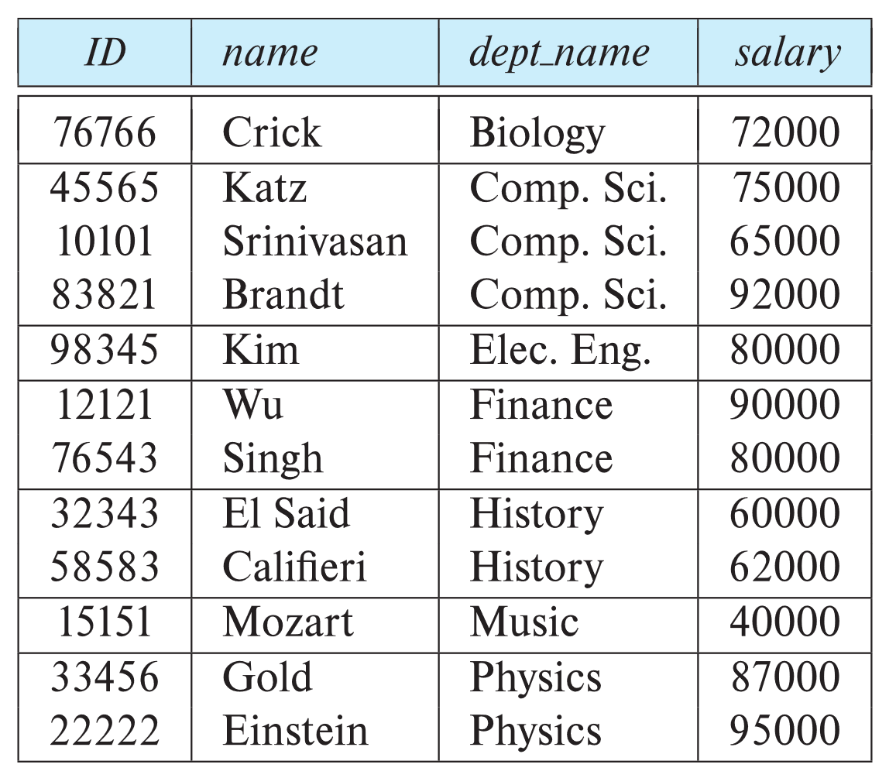
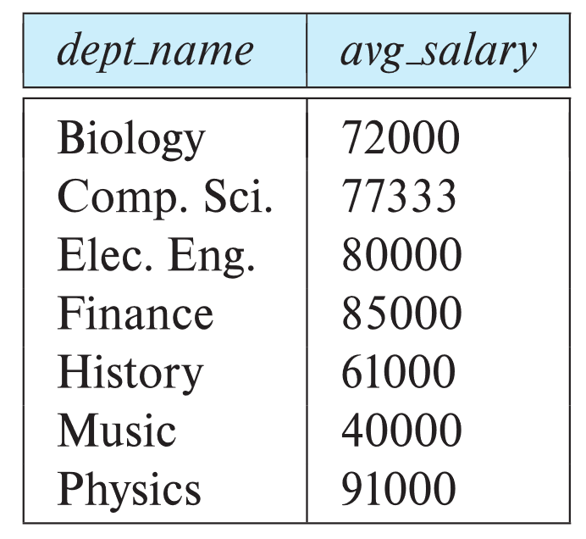
Aggregate Functions – Group By
Find the average salary of instructors in each department
select dept_name, avg (salary) as avg_salary from instructor group by dept_name;
Notes:
There are circumstances where we would like to apply the aggregate function not only to a single set of tuples, but also to a group of sets of tuples; we specify this in SQL using the group by clause. The attribute or attributes given in the group by clause are used to form groups. Tuples with the same value on all attributes in the group by clause are placed in one group.
As an illustration, consider the query “Find the average salary in each department.” We write this query as follows:

Slide 35
Aggregation (Cont.)
Find the number of instructors in each department who teach a course in the Spring 2018 semester.
select dept_name, count (distinct ID) as instr count
from instructor, teaches
where instructor.ID= teaches.ID and semester = 'Spring' and year = 2018
group by dept_name;
Attributes in select clause outside of aggregate functions must appear in group by list
/* erroneous query */ select dept_name, ID, avg (salary) from instructor group by dept_name;
Notes:
As another example of aggregation on groups of tuples, consider the query “Find the number of instructors in each department who teach a course in the Spring 2018 semester.” Information about which instructors teach which course sections in which semester is available in the teaches relation. However, this information has to be joined with information from the instructor relation to get the department name of each instructor. Thus, we write this query as follows:
select dept_name, count (distinct ID) as instr count
from instructor, teaches
where instructor.ID= teaches.ID and semester = 'Spring' and year = 2018
group by dept_name;
When an SQL query uses grouping, it is important to ensure that the only attributes that appear in the select statement without being aggregated are those that are present in the group by clause. In other words, any attribute that is not present in the group by clause may appear in the select clause only as an argument to an aggregate function, otherwise the query is treated as erroneous. For example, the following query is erroneous since ID does not appear in the group by clause, and yet it appears in the select clause without being aggregated:
Query-to na slajd vtoroto

Slide 36
Aggregate Functions – Having Clause
Find the names and average salaries of all departments whose average salary is greater than 42000
Note: predicates in the having clause are applied after the formation of groups whereas predicates in the where clause are applied before forming groups
select dept_name, avg (salary) as avg_salary
from instructor
group by dept_name
having avg (salary) > 42000;
Notes:
At times, it is useful to state a condition that applies to groups rather than to tuples. For example, we might be interested in only those departments where the average salary of the instructors is more than $42,000. This condition does not apply to a single tuple; rather, it applies to each group constructed by the group by clause. To express such a query, we use the having clause of SQL. SQL applies predicates in the having clause after groups have been formed, so aggregate functions may be used in the having clause. We express this query in SQL as follows:
The meaning of a query containing aggregation, group by, or having clauses is defined by the following sequence of operations:
As was the case for queries without aggregation, the from clause is first evaluated to get a relation.
If a where clause is present, the predicate in the where clause is applied on the result relation of the from clause.
Tuples satisfying the where predicate are then placed into groups by the group by clause if it is present. If the group by clause is absent, the entire set of tuples satisfying the where predicate is treated as being in one group.
4. The having clause, if it is present, is applied to each group; the groups that do not satisfy the having clause predicate are removed.
5. The select clause uses the remaining groups to generate tuples of the result of the query, applying the aggregate functions to get a single result tuple for each group.

Slide 37
Nested Subqueries
SQL provides a mechanism for the nesting of subqueries. A subquery is a select-from-where expression that is nested within another query.
The nesting can be done in the following SQL query select A₁, A₂, ..., A_{n} from r₁, r₂, ..., r_{m} where P
as follows:
From clause: r_{i} can be replaced by any valid subquery
Where clause: P can be replaced with an expression of the form:
B <operation> (subquery)
B is an attribute and <operation> to be defined later.
Select clause:
A_{i} can be replaced be a subquery that generates a single value.
Notes:
SQL provides a mechanism for nesting subqueries. A subquery is a select-from-where expression that is nested within another query. A common use of subqueries is to perform tests for set membership, make set comparisons, and determine set cardinality by nesting subqueries in the where clause.

Slide 38
Set Membership

Slide 39
Set Membership
Find courses offered in Fall 2017 and in Spring 2018
Find courses offered in Fall 2017 but not in Spring 2018
select distinct course_id
from section
where semester = 'Fall' and year= 2017 and course_id in (select course_id
from section
where semester = 'Spring' and year= 2018);
select distinct course_id
from section
where semester = 'Fall' and year= 2017 and course_id not in (select course_id
from section
where semester = 'Spring' and year= 2018);
Notes:
Uste eeden slajd da se stavi prethodno
SQL allows testing tuples for membership in a relation. The in connective tests for set membership, where the set is a collection of values produced by a select clause. The not in connective tests for the absence of set membership.
As an illustration, reconsider the query “Find all the courses taught in the both the Fall 2017 and Spring 2018 semesters.” Earlier, we wrote such a query by intersecting two sets: the set of courses taught in Fall 2017 and the set of courses taught in Spring 2018. We can take the alternative approach of finding all courses that were taught in Fall 2017 and that are also members of the set of courses taught in Spring 2018. This formulation generates the same results as the previous one did, but it leads us to write our query using the in conective of SQL. We begin by finding all courses taught in Spring 2018, and we write the subquery:
(select course id
from section
where semester = 'Spring' and year= 2018)
We then need to find those courses that were taught in the Fall 2017 and that appear in the set of courses obtained in the subquery. We do so by nesting the subquery in the where clause of an outer query. The resulting query is:
select distinct course_id
from section
where semester = 'Fall' and year= 2017 and course_id in (select course_id
from section
where semester = 'Spring' and year= 2018);
Note that we need to use distinct here because the intersect operation removes duplicates by default. This example shows that it is possible to write the same query several ways in SQL.
This flexibility is beneficial, since it allows a user to think about the query in the way that seems most natural. We shall see that there is a substantial amount of redundancy in SQL. We use the not in construct in a way similar to the in construct.
For example, to find all the courses taught in the Fall 2017 semester but not in the Spring 2018 semester, which we expressed earlier using the except operation, we can write:
select distinct course_id
from section
where semester = 'Fall' and year= 2017 and course_id not in (select course_id
from section
where semester = 'Spring' and year= 2018);

Slide 40
Set Membership (Cont.)
Name all instructors whose name is neither “Mozart” nor Einstein”
select distinct name
from instructor
where name not in ('Mozart', 'Einstein')
Find the total number of (distinct) students who have taken course sections taught by the instructor with ID 10101
Note: Above query can be written in a much simpler manner. The formulation above is simply to illustrate SQL features
select count (distinct ID)
from takes
where (course_id, sec_id, semester, year) in (select course_id, sec_id, semester, year
from teaches
where teaches.ID= 10101);
Notes:
The in and not in operators can also be used on enumerated sets. The following query selects the names of instructors whose names are neither “Mozart” nor “Einstein”.
In the preceding examples, we tested membership in a one-attribute relation. It is also possible to test for membership in an arbitrary relation in SQL. For example, we can write the query “find the total number of (distinct) students who have taken course sections taught by the instructor with ID 110011” as follows:
Note, however, that some SQL implementations do not support the row construction syntax “(course_id, sec_id, semester, year)” used above. We will see alternative ways of writing this query in Section 3.8.3.

Slide 41
Set Comparison

Slide 42
Set Comparison – “some” Clause
Find names of instructors with salary greater than that of some (at least one) instructor in the Biology department.
Same query using > some clause
select distinct T.name
from instructor as T, instructor as S
where T.salary > S.salary and S.dept name = 'Biology';
select name
from instructor
where salary > some (select salary
from instructor
where dept name = 'Biology');
Notes:
As an example of the ability of a nested subquery to compare sets, consider the query “Find the names of all instructors whose salary is greater than at least one instructor in the Biology department.” In Section 3.4.1, we wrote this query as follows:
SQL does, however, offer an alternative style for writing the preceding query. The phrase “greater than at least one” is represented in SQL by > some. This construct allows us to rewrite the query in a form that resembles closely our formulation of the query in English.

Slide 43
Definition of “some” Clause
F <comp> some r ⇔ ∃ t ∈ r such that (F <comp> t ) Where <comp> can be: <, ≤, >, =, ≠
0
(5 < some
5
) = true
(read: 5 < some tuple in the relation)
6
0
(5 < some
5
) = false
0
(5 = some
) = true
5
0
(5 ≠ some
5
) = true (since 0 ≠ 5)
(= some) ≡ in
However, (≠ some) ≡ not in
Notes:
The subquery:
(select salary
from instructor
where dept_name = 'Biology')
generates the set of all salary values of all instructors in the Biology department. The > some comparison in the where clause of the outer select is true if the salary value of the tuple is greater than at least one member of the set of all salary values for instructors in Biology.
SQL also allows < some, <= some, >= some, = some, and <> some comparisons. As an exercise, verify that = some is identical to in, whereas <> some is not the same as not in.

Slide 44
Set Comparison – “all” Clause
Find the names of all instructors whose salary is greater than the salary of all instructors in the Biology department.
select name
from instructor
where salary > all (select salary
from instructor
where dept name = 'Biology');
Notes:
Now we modify our query slightly. Let us find the names of all instructors that have a salary value greater than that of each instructor in the Biology department. The construct > all corresponds to the phrase “greater than all.” Using this construct, we write the query as follows:

Slide 45
Definition of “all” Clause
F <comp> all r ⇔ ∀ t ∈ r (F <comp> t)
0
(5 < all
5
) = false
6
6
(5 < all
) = true
10
4
(5 = all
) = false
5
4
(5 ≠ all
) = true (since 5 ≠ 4 and 5 ≠ 6)
6
(≠ all) ≡ not in
However, (= all) ≡ in
Notes:
As it does for some, SQL also allows < all, <= all, >= all, = all, and <> all comparisons. As an exercise, verify that <> all is identical to not in, whereas = all is not the same as in.

Slide 46
Test for Empty Relations
The exists construct returns the value true if the argument subquery is nonempty.
exists r ⇔ r ≠ Ø
not exists r ⇔ r = Ø

Slide 47
Use of “exists” Clause
Yet another way of specifying the query “Find all courses taught in both the Fall 2017 semester and in the Spring 2018 semester”
select course_id from section as S where semester = 'Fall' and year = 2017 and exists (select * from section as T where semester = 'Spring' and year= 2018 and S.course_id = T.course_id);
Correlation name – variable S in the outer query
Correlated subquery – the inner query
Notes:
SQL includes a feature for testing whether a subquery has any tuples in its result. The exists construct returns the value true if the argument subquery is nonempty. Using the exists construct, we can write the query “Find all courses taught in both the Fall 2017 semester and in the Spring 2018 semester” in still another way:
The above query also illustrates a feature of SQL where a correlation name from an outer query (S in the above query), can be used in a subquery in the where clause. A subquery that uses a correlation name from an outer query is called a correlated subquery.

Slide 48
Use of “not exists” Clause
Find all students who have taken all courses offered in the Biology department.
Note that X – Y = Ø ⇔ X ⊆ Y
Note: Cannot write this query using = all and its variants
select distinct S.ID, S.name
from student as S
where not exists ( (select course_id
from course
where dept_name = 'Biology')
except
(select T.course_id
from takes as T
where S.ID = T.ID));
First nested query lists all courses offered in Biology
Second nested query lists all courses a particular student took
Notes:
We can test for the nonexistence of tuples in a subquery by using the not exists construct. We can use the not exists construct to simulate the set containment (that is, superset) operation: We can write “relation A contains relation B” as “not exists (B except A).” (Although it is not part of the current SQL standards, the contains operator was present in some early relational systems.) To illustrate the not exists operator, consider the query “Find all students who have taken all courses offered in the Biology department.” Using the except construct, we can write the query as follows:
Here, the subquery:
(select course id from course where dept_name = 'Biology')
finds the set of all courses offered in the Biology department.
The subquery:
(select T.course id from takes as T where S.ID = T.ID)
finds all the courses that student S.ID has taken.
Thus, the outer select takes each student and tests whether the set of all courses that the student has taken contains the set of all courses offered in the Biology department.

Slide 49
Test for Absence of Duplicate Tuples
The unique construct tests whether a subquery has any duplicate tuples in its result.
The unique construct evaluates to “true” if a given subquery contains no duplicates .
Find all courses that were offered at most once in 2017
select T.course_id from course as T where unique ( select R.course_id from section as R where T.course_id= R.course_id and R.year = 2017);
Notes:
SQL includes a Boolean function for testing whether a subquery has duplicate tuples in its result. The unique construct returns the value true if the argument subquery contains no duplicate tuples. Using the unique construct, we can write the query “Find all courses that were offered at most once in 2017” as follows:

Slide 50
End of Chapter 3

